Slide 1
Power BI + React
Creating and Using Custom Visuals
Matt Nawrocki

Slide 2
Agenda
Overview Presentation
ELI5 React
Why Use These Together?
Demo with Code
PowerBI Custom Visual Development
React Integration
Packaging the Visual
GitHub Repo
Complementary Libraries & Software
Open Ideation Session
Project Ideas
Clients

Slide 3

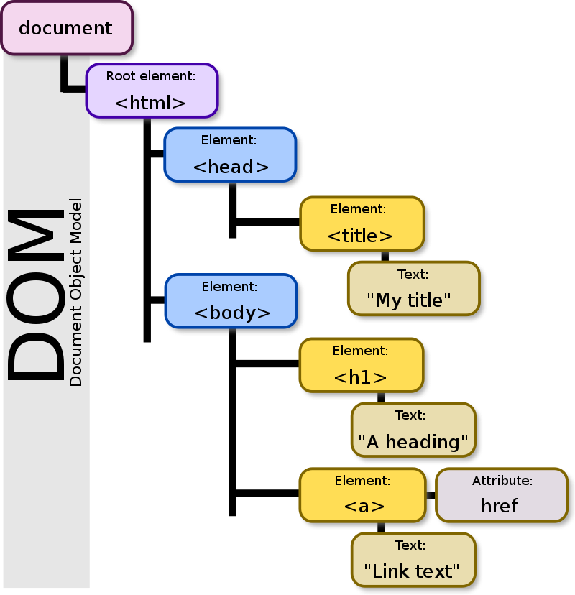
ELI5 React
It’s basically the love-child of HTML & JavaScript (JS)
Originated from Facebook
Leveraging JS dramatically improves speed
React ”virtualizes” (think side-chain) the DOM (think tree structures) and intelligently decides how to act
Components using functional programming paradigm
Very naturally allows for things like:
State management with deterministic outcomes
The general idea is that there are these things called “pure functions” that prevent “side effects”
Highly-modular and reusable code
Build it once and use it a bunch of times without modification
Histories (think Undo/Redo features in Word)
React Example
The Documen Object Model (DOM) is the basis of the HTML-based web. However, operations on the DOM are expensive, so React does whatever processing it can outside of the DOM.

Slide 4
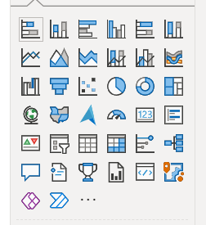
Why Use These Together? A High-Level Overview
PowerBI covers most of the visualization basics, but it’s still (mostly) just the basics.
Bar charts, line, pie, table, etc.
Microsoft is likely to continue to be a dominant player in data and visualization
Azure / Cloud
Mobile devices
Augment reality
Data Science digestion can be difficult, and is greatly aided by visualization capabilities
PowerBI does not serve complex visualizations directly
You can bring the Web to PBI, dramatically enhancing its capabilities
As blockchain technology matures, JS interfacing can empower connectivity between Web 2.0 & 3.0
Catalog of the visuals provided by PowerBI out-of-the-box.

Slide 5
Why Use These Together? A Slightly Less-High-Level Overview
PowerBI
Handles all of the data side facilitation
Connections
Transformations
Robust, production-grade visualization platform
Cloud-based
PBIVIZ Package
The “middleware” layer between PowerBI and React
React
Handles all of the custom visualization
Highly-modular, reusable components
Functional programming

Slide 6
Why Use These Together? AN even Slightlier Less-High-Level Overview
All of the familiar Software Engineering paradigms and workflows still apply
Unit testing
Separation of concerns
Composability
Reusability
Etc.
All of the data pipelines and visualizations processes remain identical
ETL processes and ingestion
DAX/PowerQuery
Measures, relationships, Mquery, etc.
Data visualizations
Etc.
Salient Point:
You basically get the best of both worlds, without any meaningful tradeoffs
Software practices ensure production-grade code and reliability
Data practices ensure production-grade data pipelines and transformations

Slide 7
Demo

Slide 8
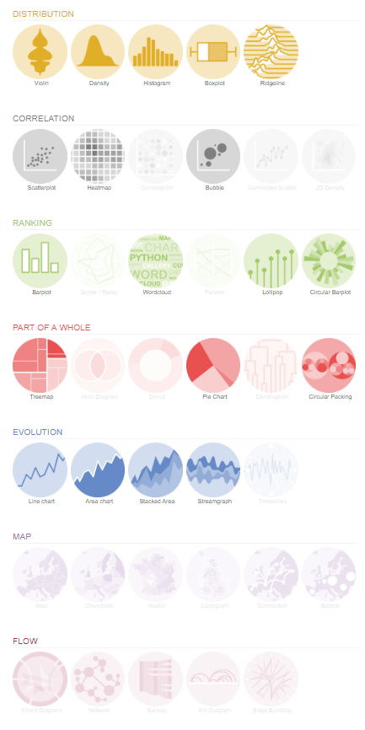
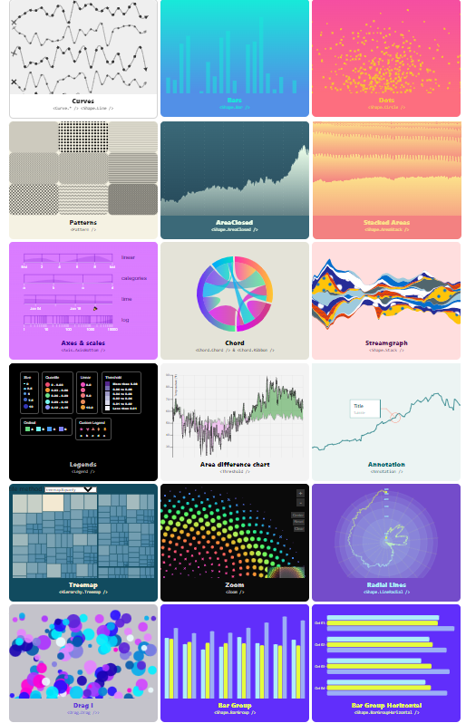
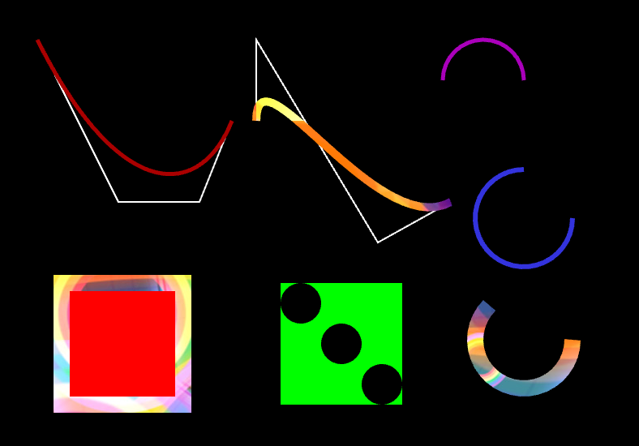
Chart & Drawing Libraries
Charting Libraries
https://airbnb.io/visx/gallery
https://uber.github.io/react-vis/
https://nivo.rocks/chord/canvas/
https://www.react-graph-gallery.com/
Graphics Libraries
https://d3js.org/
https://observablehq.com/@d3/gallery
https://pixijs.com/
https://pixijs.io/examples/#/demos-basic/container.js

Slide 9
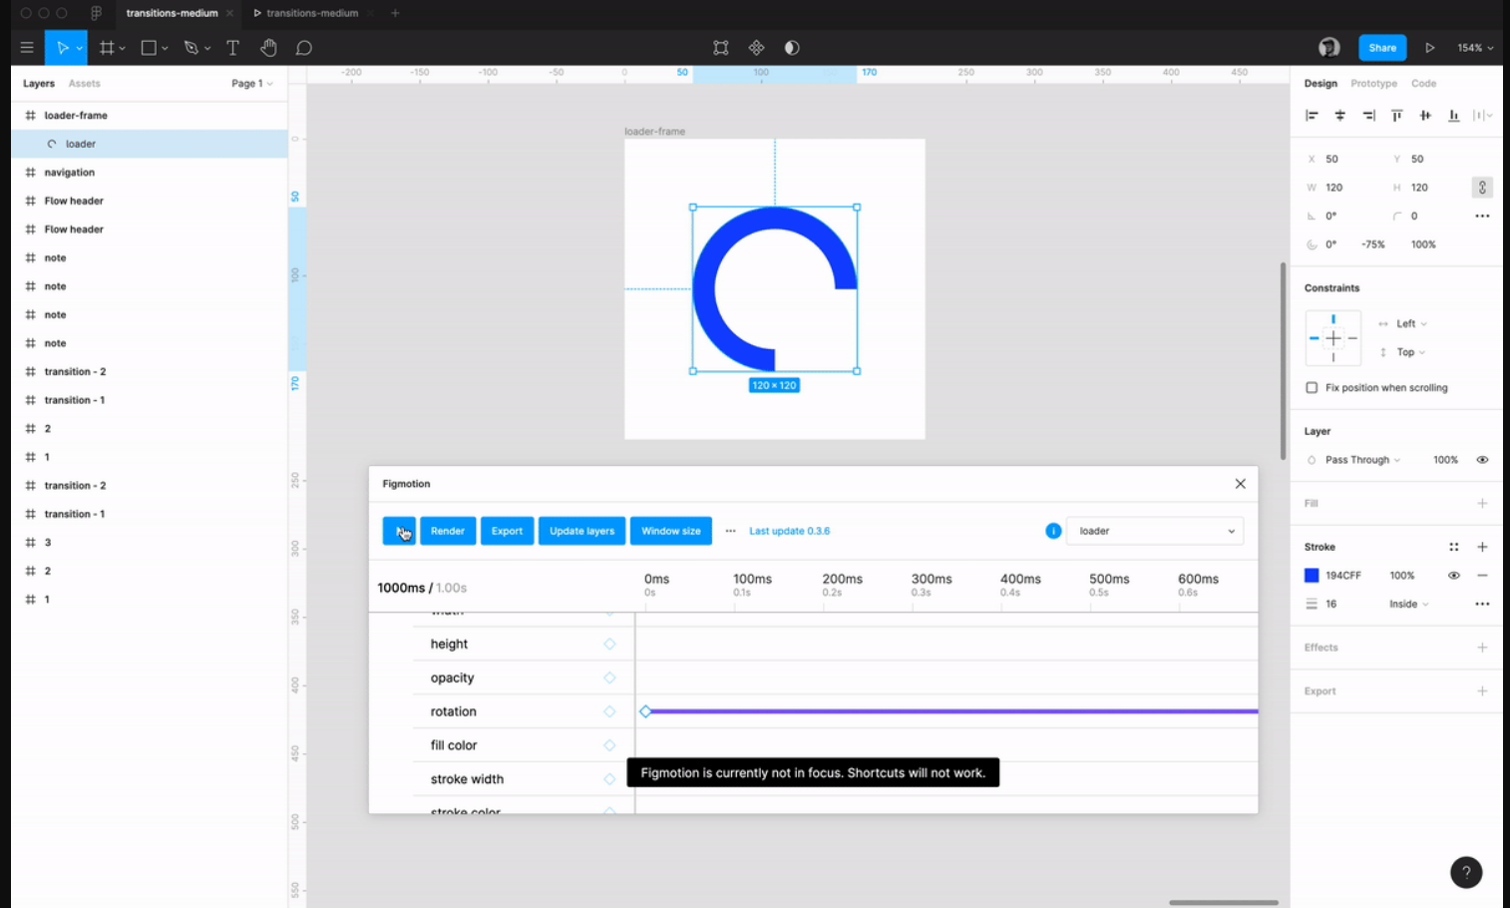
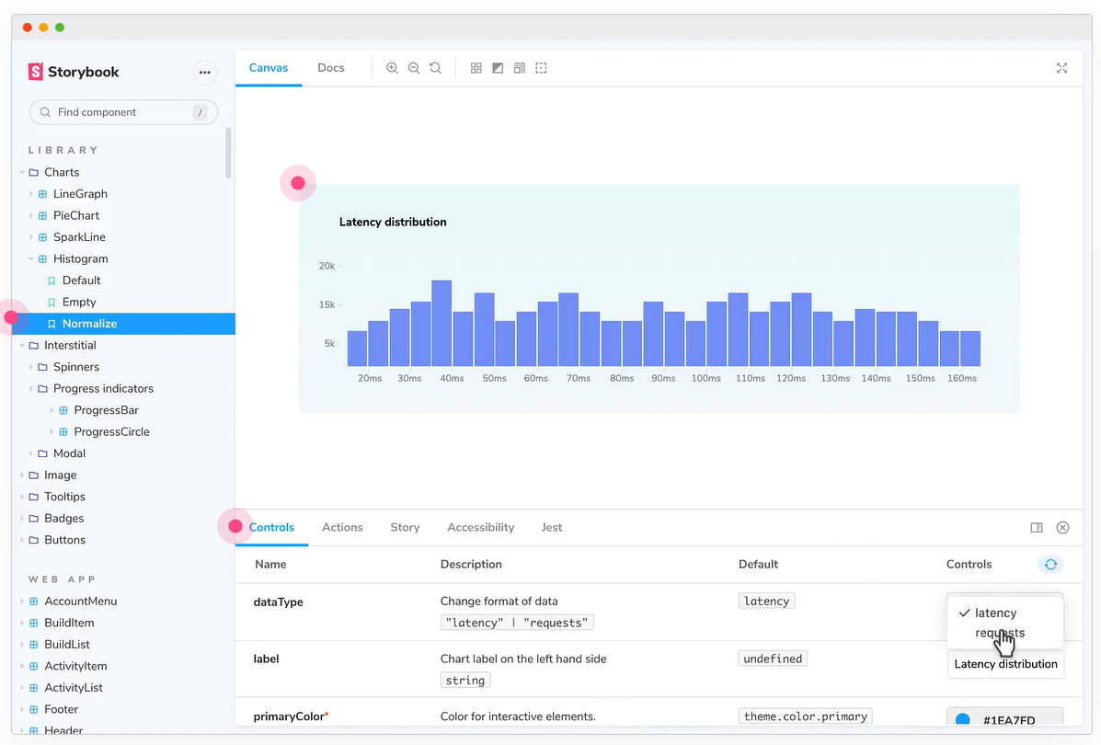
Creative & Support Tools
Figma
Figma is a web & desktop design tool that uses a graph-like node structure to organize its design components, leveraging a blend of Photoshop and CSS principles.
Storybook
Storybook allows UX, QA, and Devs to organize and validate their React components in a state-managed sandbox environment.

Slide 10


